Slide 1


From 6 Weeks to 6 Minutes… …Almost!
Shakeel Sorathia
Notes:
Speak my name slowly.

Slide 2


Ticketmaster
We are part of Live Nation Entertainment
You may have heard of us…
We sell a few tickets
7 Data Centers worldwide
20,000+ OS images (VM’s and bare metal)
Transactions > $16B Worldwide
Onsales > $1M/minute
255M+ user accounts

Slide 3
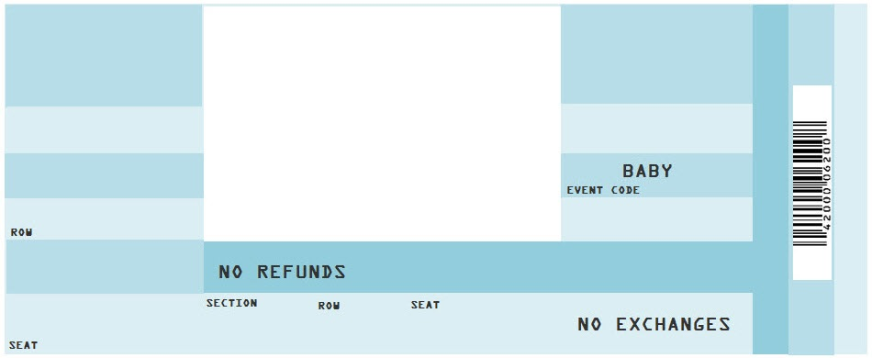
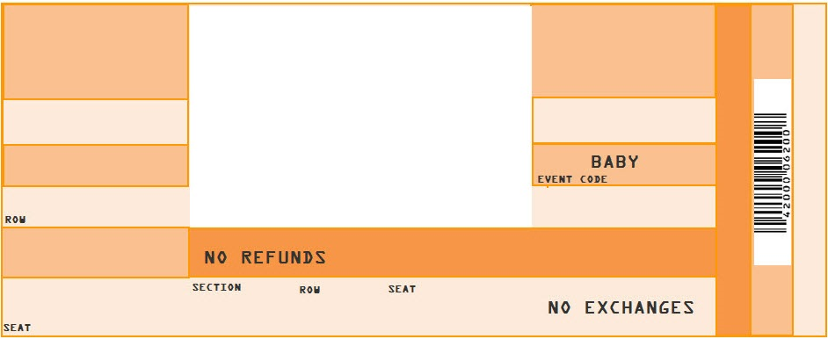
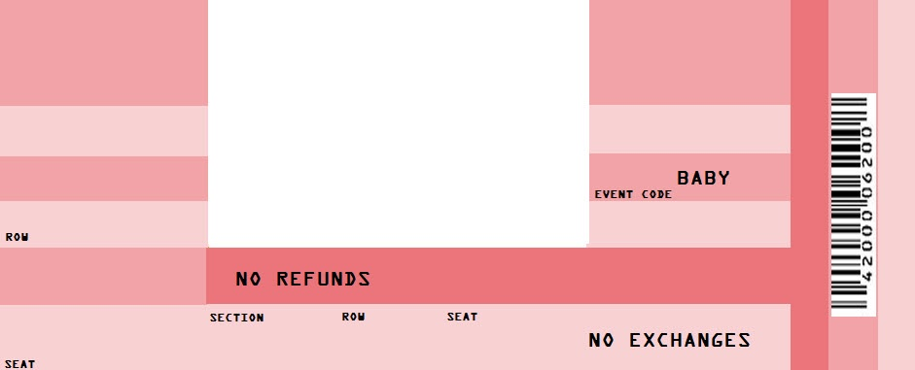

Here’s our story
Challenge Here’s what was going on backstage…
Solution On with the show…
Impact The reviews are in…

Slide 4
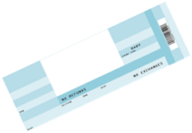
Early Tactical Solutions
Challenge
2001
2003
2004
2005
Management through M4
Implemented virtualization in development environments
Developed Spine (rubix) for CMS
Scaled out 150% for Yankee's onsale within 48 hours
Notes:
This is what we were doing to set us up early on. Number of tactical solutions that were put into place because of many of the issues that we had.
Yankee fans are a little bit on the crazy side. 80 games, 70k tickets per game. Took 8 hours to sell through about 1.5 mil tickets.
Define rubix a bit better.

Slide 5
And then…
Challenge
2008
Our split from IACI saddled us with $750M in debt
The economy forced a cost-driven mindset
Our initial proposal for internal cloud approved due to cost savings
Notes:
Talk about the lack of innovation between 2008-2010. No money for innovation, all the money went to the cloud project.
Cloud ROI was going to save money compared to running bare metal servers.

Slide 6
We reached a turning point…
Challenge
2010
Merged with Live Nation
Faced a key decision to turtle or grow; we chose growth!
The re-architecture of the platform began
This led to the development of a real DevOps strategy
Notes:
Why did we face the decisions (2008 economy, new leadership wasn’t sure what to do)
Springsteen lawsuit just settled which made resale a difficult line of business for us. Talk through the lawsuit (redirected to ticketsnow (our resale site), had to refund over $1M)
Devops started with jetson (the new platform)

Slide 7
We face a lot of uncertainty and potential pitfalls in an enterprise…
There were a lot of questions to answer…
Fan Experience
Employee Experience
Dollars & Sense

Slide 8
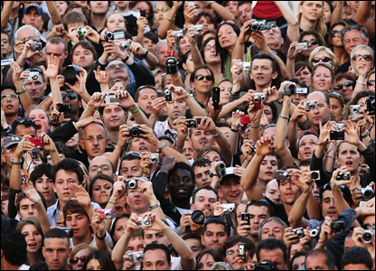
Fan Experience
Will we be able to provide an equal or better product?
Will this result in faster time-to-market for our requested features?
Will our fans have to deal with problems while we figure things out?

Slide 9

Employee Experience
How will people in the company adapt?
What type of training will they need?
How do we overcome fear in the minds of our people?
How do we share the vision for the future?

Slide 10

Dollars and Sense
How much will this cost us?
What about learning pains, what will that cost?
Will our sales be better if we do this?
How will we know if this is working?

Slide 11
Where we started
Challenge
17 different ticketing systems
30 year old technology
Hard split between Development and Operations teams
Product release cycles were bi-monthly to quarterly
Notes:
17 ticketing systems, M&A activity, great on the A, not so much on the M.
Development would build the product and then throw it over the wall to operations

Slide 12
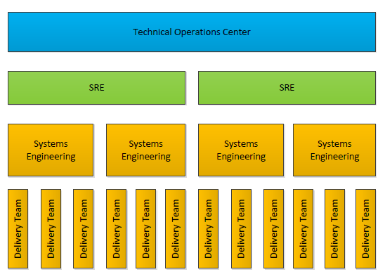
Here’s what we did…
Solution
Developed a tier 1 TOC
Developed an SRE team
Aligned Systems Engineering to delivery teams
Empowered developers to push code to production
Notes:
How did we chose the place to start.
When did we start doing this? 1.5 – 2 years ago.

Slide 13
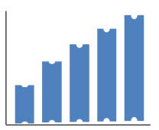
What has this achieved?
Impact
51% of all services/products are deployed by development teams
Development teams now have an on call
109 Deployments in Sept
490 Alerts resolved by TOC
Notes:
Number of releases 2 years ago. Number of releases today.
Time to do deployments. Old products are still taking a long time to release. New products are released far quicker
One service is doing 15 deployments per month
490 * 5 minutes is 40 hours (1 man week)

Slide 14
What has this achieved?
Impact
Ticketmaster Resale is up 30% for first half of 2014
Increase in Customer Service Rating
In general, how would you rate the stability of Ticketmaster products/services?

Slide 15
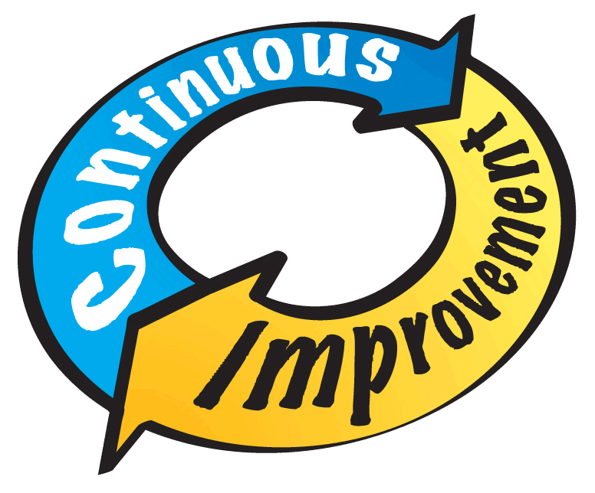
And it continues…
Impact
We strive for continuous refinement
We are pushing more services to the edge
Customer service tools
Client Services tools for event building
We continue to train people in new methodologies
Lean PMO
Agile (Scrum/Kanban)
Notes:
Continuous refine
Pushing more services to the edge
Continue to train people in new methodologies

Slide 16
Things we don’t know
Impact
How many people should be aligned in Systems Engineering?
What should some of the responsibilities be for the different roles?
How does infosec fit into all of this?
What other metrics should we be looking at?

